Slide 1
Loan Approval Prediction
Predicting Loan Approval Status using Machine Learning Models
By: Sumukh Shirish Dhumal

Slide 2
Aim
To develop a predictive model to accurately predict loan approval status based on features like credit score, annual income, loan amount, etc.
Objective
Analyze the dataset to understand the distribution and relationships of the features.
Create new features and preprocess data to improve model performance.
Visualize the data to identify patterns and correlations that influence loan approval.
Compare various machine learning models to find the best performing one.
Optimize the chosen models to improve their accuracy and performance.
Evaluate models using metrics such as accuracy, F1 score, and classification report.
Implement the best model for practical loan approval predictions.
Summarize findings and propose future improvements for the model.

Slide 3
Libraries and Dataset
Libraries Used:
NumPy
Pandas
Matplotlib
Seaborn
Scikit-Learn
XGBoost
Dataset: Loaded from loan_approval_dataset.csv

Slide 4
Feature Description
Columns in Dataset:
loan_id: Unique ID (Dropped)
no_of_dependents
education: Graduate/Not Graduate
self_employed: Employment Status
income_annum
loan_amount
loan_term
cibil_score: Credit Score
residential_assets_value
commercial_assets_value
luxury_assets_value
bank_asset_value
loan_status: Approved/Rejected

Slide 5
Feature Engineering
Dropped: loan_id
Created New Features:
Movable_assets
Immovable_assets
Dropped Columns:
bank_asset_value, luxury_assets_value, residential_assets_value, commercial_assets_value

Slide 6
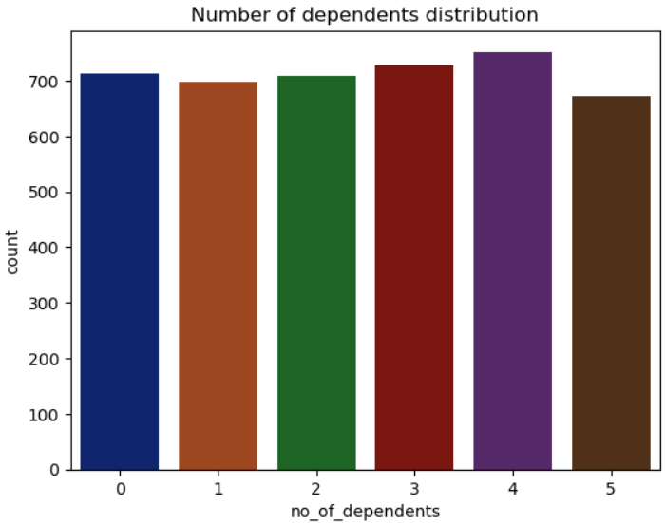
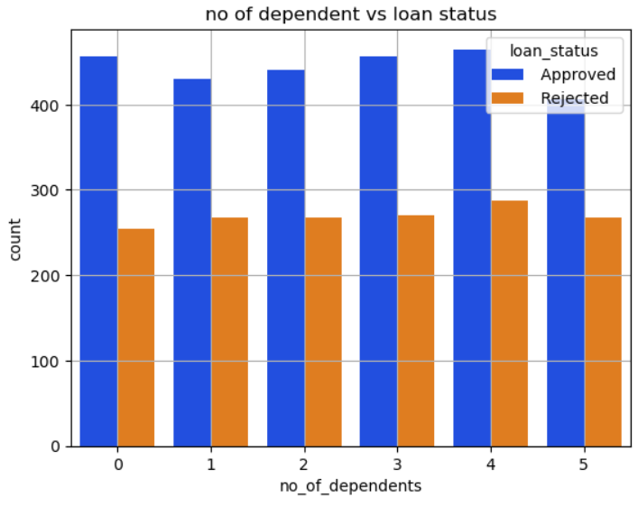
Visualizations
This graph illustrate the count of dependents of loan applicants
When someone has more family members they take care of, their chances of loan rejection go up. But what's interesting is that the number of people who get loans approved doesn't change much, even if they have more family members.

Slide 7
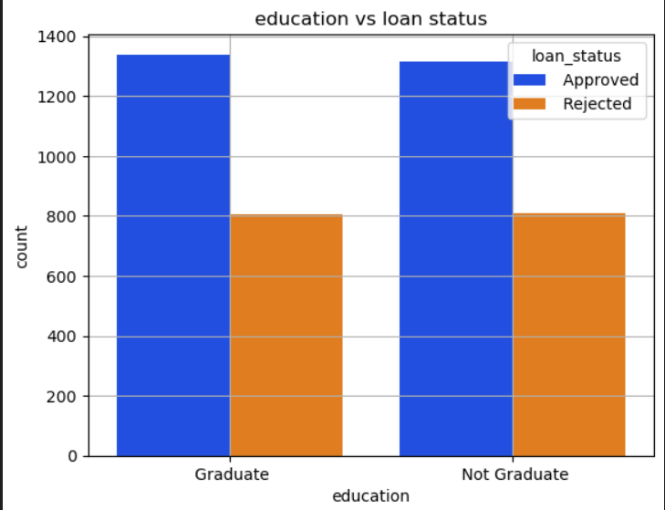
Education vs Loan Status
The graph indicates that there's only a small difference between the number of loans approved and rejected for both graduate and non-graduate applicants. This difference is so small that it doesn't seem to be significant.

Slide 8
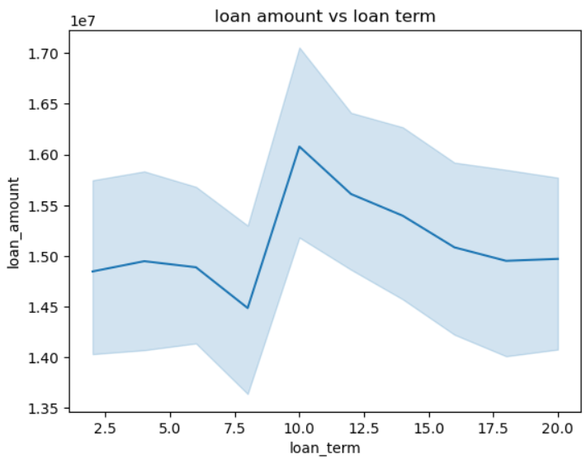
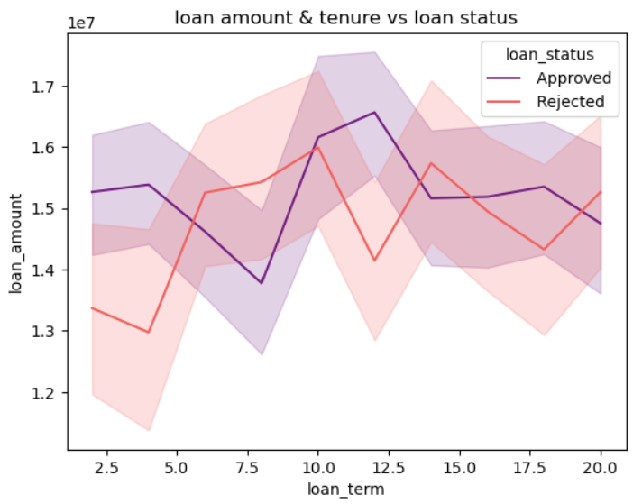
Loan Amount and Term Analysis
This line plot shows the trend between the loan amount and the loan tenure. Between the loan tenure of 2.5 - 7.5years the loan amount is between 1400000 - 15500000. However the loan amount is significantly higher for the loan tenure of 10 years.
The graph show than depending upon loan amount and time of repay, loan approval get affected. It's clear that loans that are accepted often have higher amounts and shorter repayment times. On the other hand, loans that are rejected are usually for lower amounts and longer repayment periods. This could be because the bank prefers to approve loans that are easier to pay back quickly and that bring in more profit. They might not want to deal with very small loans due to the costs involved.

Slide 9
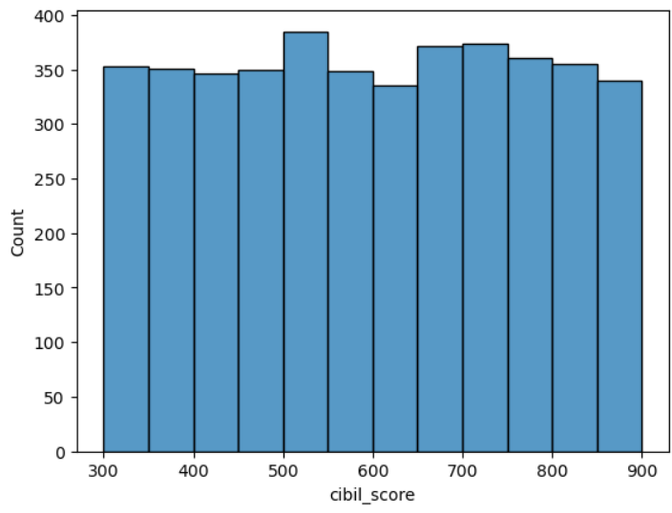
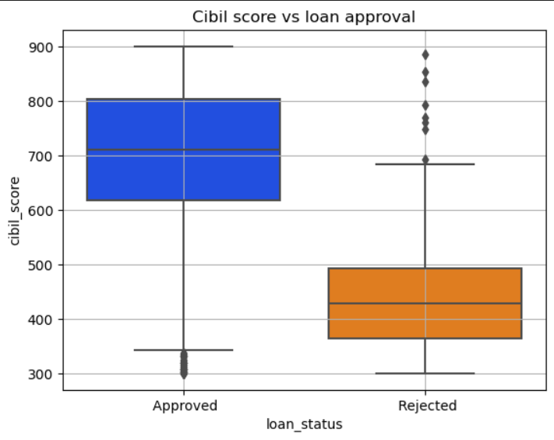
CIBIL Score Analysis
The graph shows that people who got their loans approved tend to have higher CIBIL scores, mostly above 600. But for those whose loans weren't approved, the scores are more spread out and usually lower than 550. This means having a higher CIBIL score, especially over 600, really boosts the chances of getting a loan approved. It's clear that a good CIBIL score is important for loan approval.

Slide 10
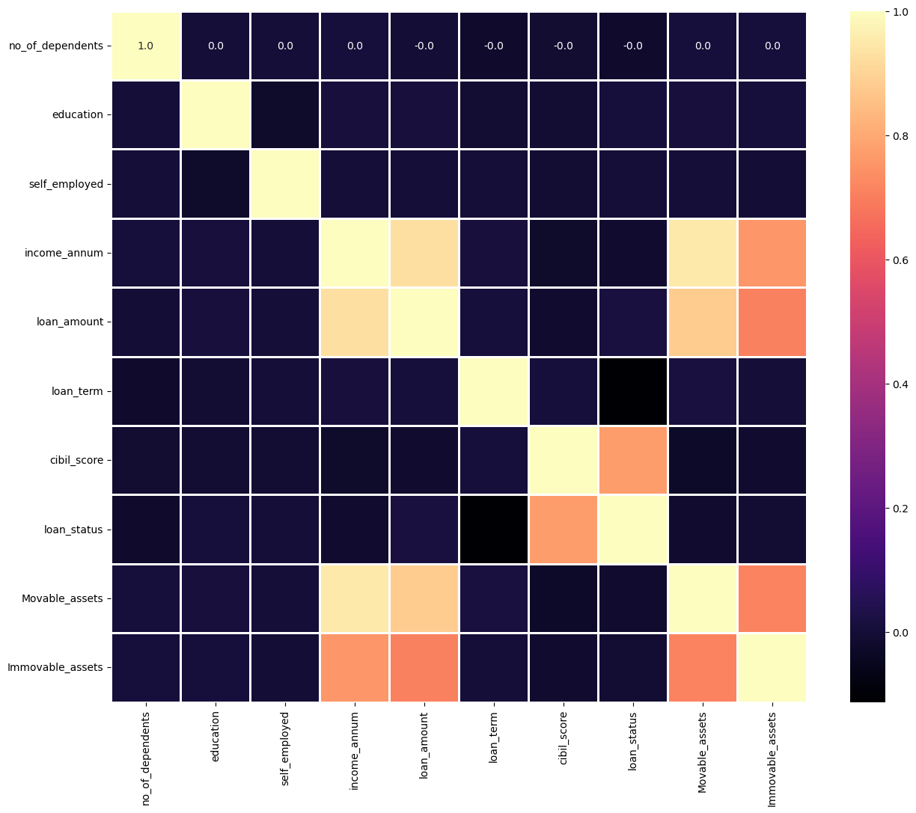
Correlation Analysis: Heatmap of Correlation Values

Slide 11
Model Evaluation
Model Performance
Models Tested:
Logistic Regression
Support Vector Classification (SVC)
Decision Tree Classifier
Random Forest Classifier
AdaBoost Classifier
Gradient Boosting Classifier
XGBoost Classifier
Decision Tree: 98% Accuracy
Random Forest: 98% Accuracy
Gradient Boosting: 98.82% Accuracy
XGBoost: 98.71% Accuracy

Slide 12
Conclusion
Best Performing Models:
Decision Tree with Hyperparameter Tuning
Gradient Boosting
XGBoost
Key Insights:
Decision Tree and Boosting Classifiers show excellent performance.
SVM and Logistic Regression performed less effectively.

